Slide 1
SQL JOINS

Slide 2
TYPES OF JOINS
INNER JOIN/JOIN
LEFT OUTER JOIN
RIGHT OUTER JOIN
FULL OUTER JOIN

Slide 3
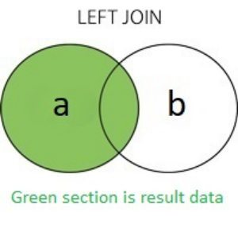
LEFT JOIN
In Oracle, (+) denotes the "optional" table in the JOIN. So in your query, SELECT a.id, b.id, a.col_2, b.col_2, ...FROM a,bWHERE a.id=b.id(+) it's a LEFT OUTER JOIN of table 'b' to table 'a'. It will return all data of table 'a' without losing its data when the other side (optional table 'b') has no data.
The modern standard syntax for the same query would be SELECT a.id, b.id, a.col_2, b.col_2, ...FROM aLEFT JOIN b ON a.id=b.id or with a shorthand for a.id=b.id (not supported by all databases): SELECT a.id, b.id, a.col_2, b.col_2, ...FROM aLEFT JOIN b USING(id)

Slide 4
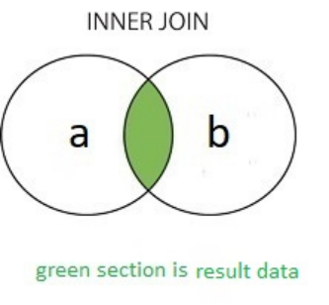
INNER JOIN
If you remove (+) then it will be normal inner join query Older syntax, in both Oracle and other databases: SELECT a.id, b.id, a.col_2, b.col_2, ...FROM a,bWHERE a.id=b.id More modern syntax: SELECT a.id, b.id, a.col_2, b.col_2, ...FROM aINNER JOIN b ON a.id=b.id Or simply: SELECT a.id, b.id, a.col_2, b.col_2, ...FROM aJOIN b ON a.id=b.id
It will only return all data where both 'a' & 'b' tables 'id' value is same, means common part.

Slide 5
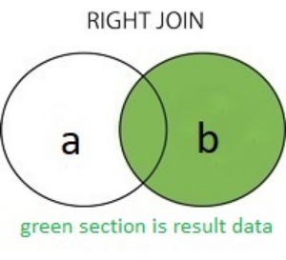
RIGHT JOIN
If you want to make your query a Right Join
This is just the same as a LEFT JOIN, but switches which table is optional.
Old Oracle syntax: SELECT a.id, b.id, a.col_2, b.col_2, ...FROM a,bWHERE a.id(+)=b.id Modern standard syntax: SELECT a.id, b.id, a.col_2, b.col_2, ...FROM aRIGHT JOIN b ON a.id=b.id

Slide 6
FULL OUTER JOIN
Fetches all columns from both table.(Left join + right join).
SYNTAX:
SELECT <COLUMN_LIST>
FROM <TABLE_NAME 1> AS T1
FULL JOIN <TABLE_NAME 1> AS T2
ON T1.COLUMN_NAME = T2.COLUMN_NAME

Slide 7
END

